Slide 1


Pre-Post Test Analysis
Kaushambi, UP

Slide 2
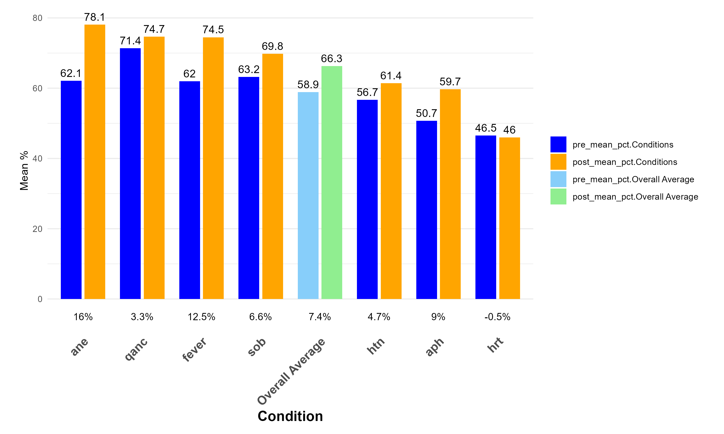
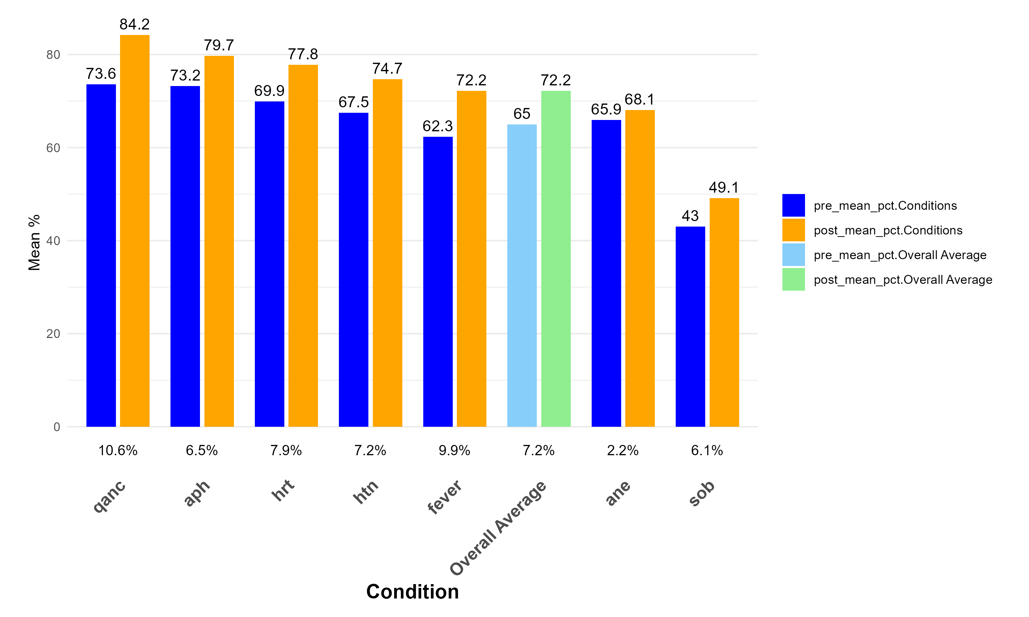
Mean pre-post percentage of MO & SN
MO
SN

Slide 3
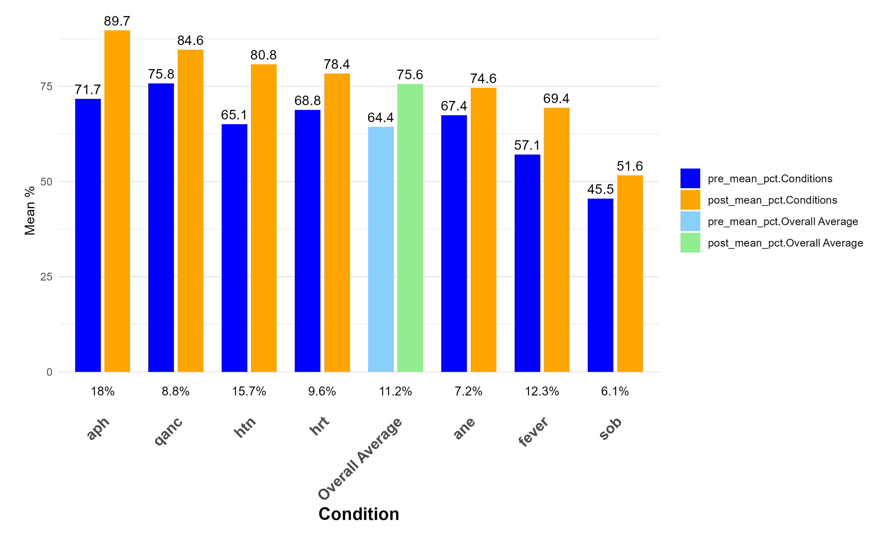
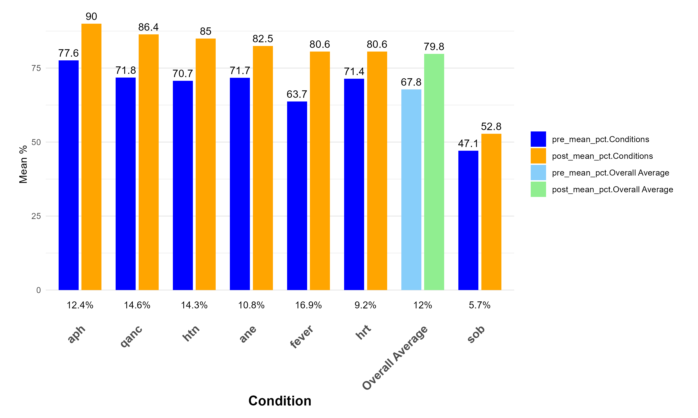
Mean pre-post percentage of ANM & CHO
ANM
CHO

Slide 4
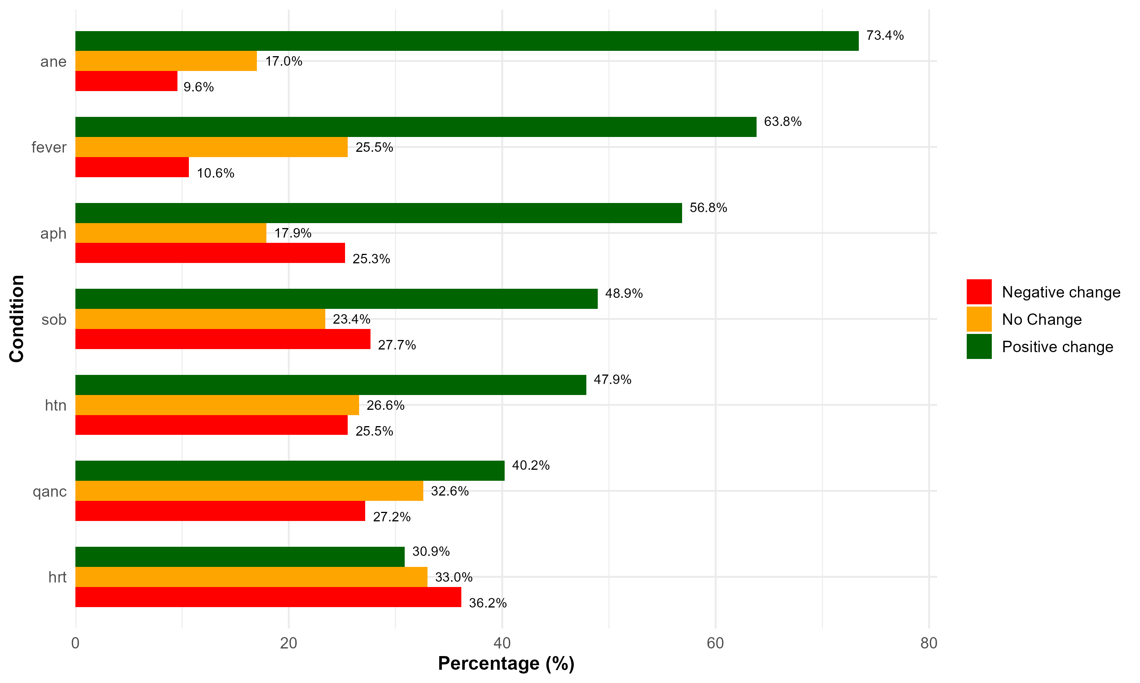
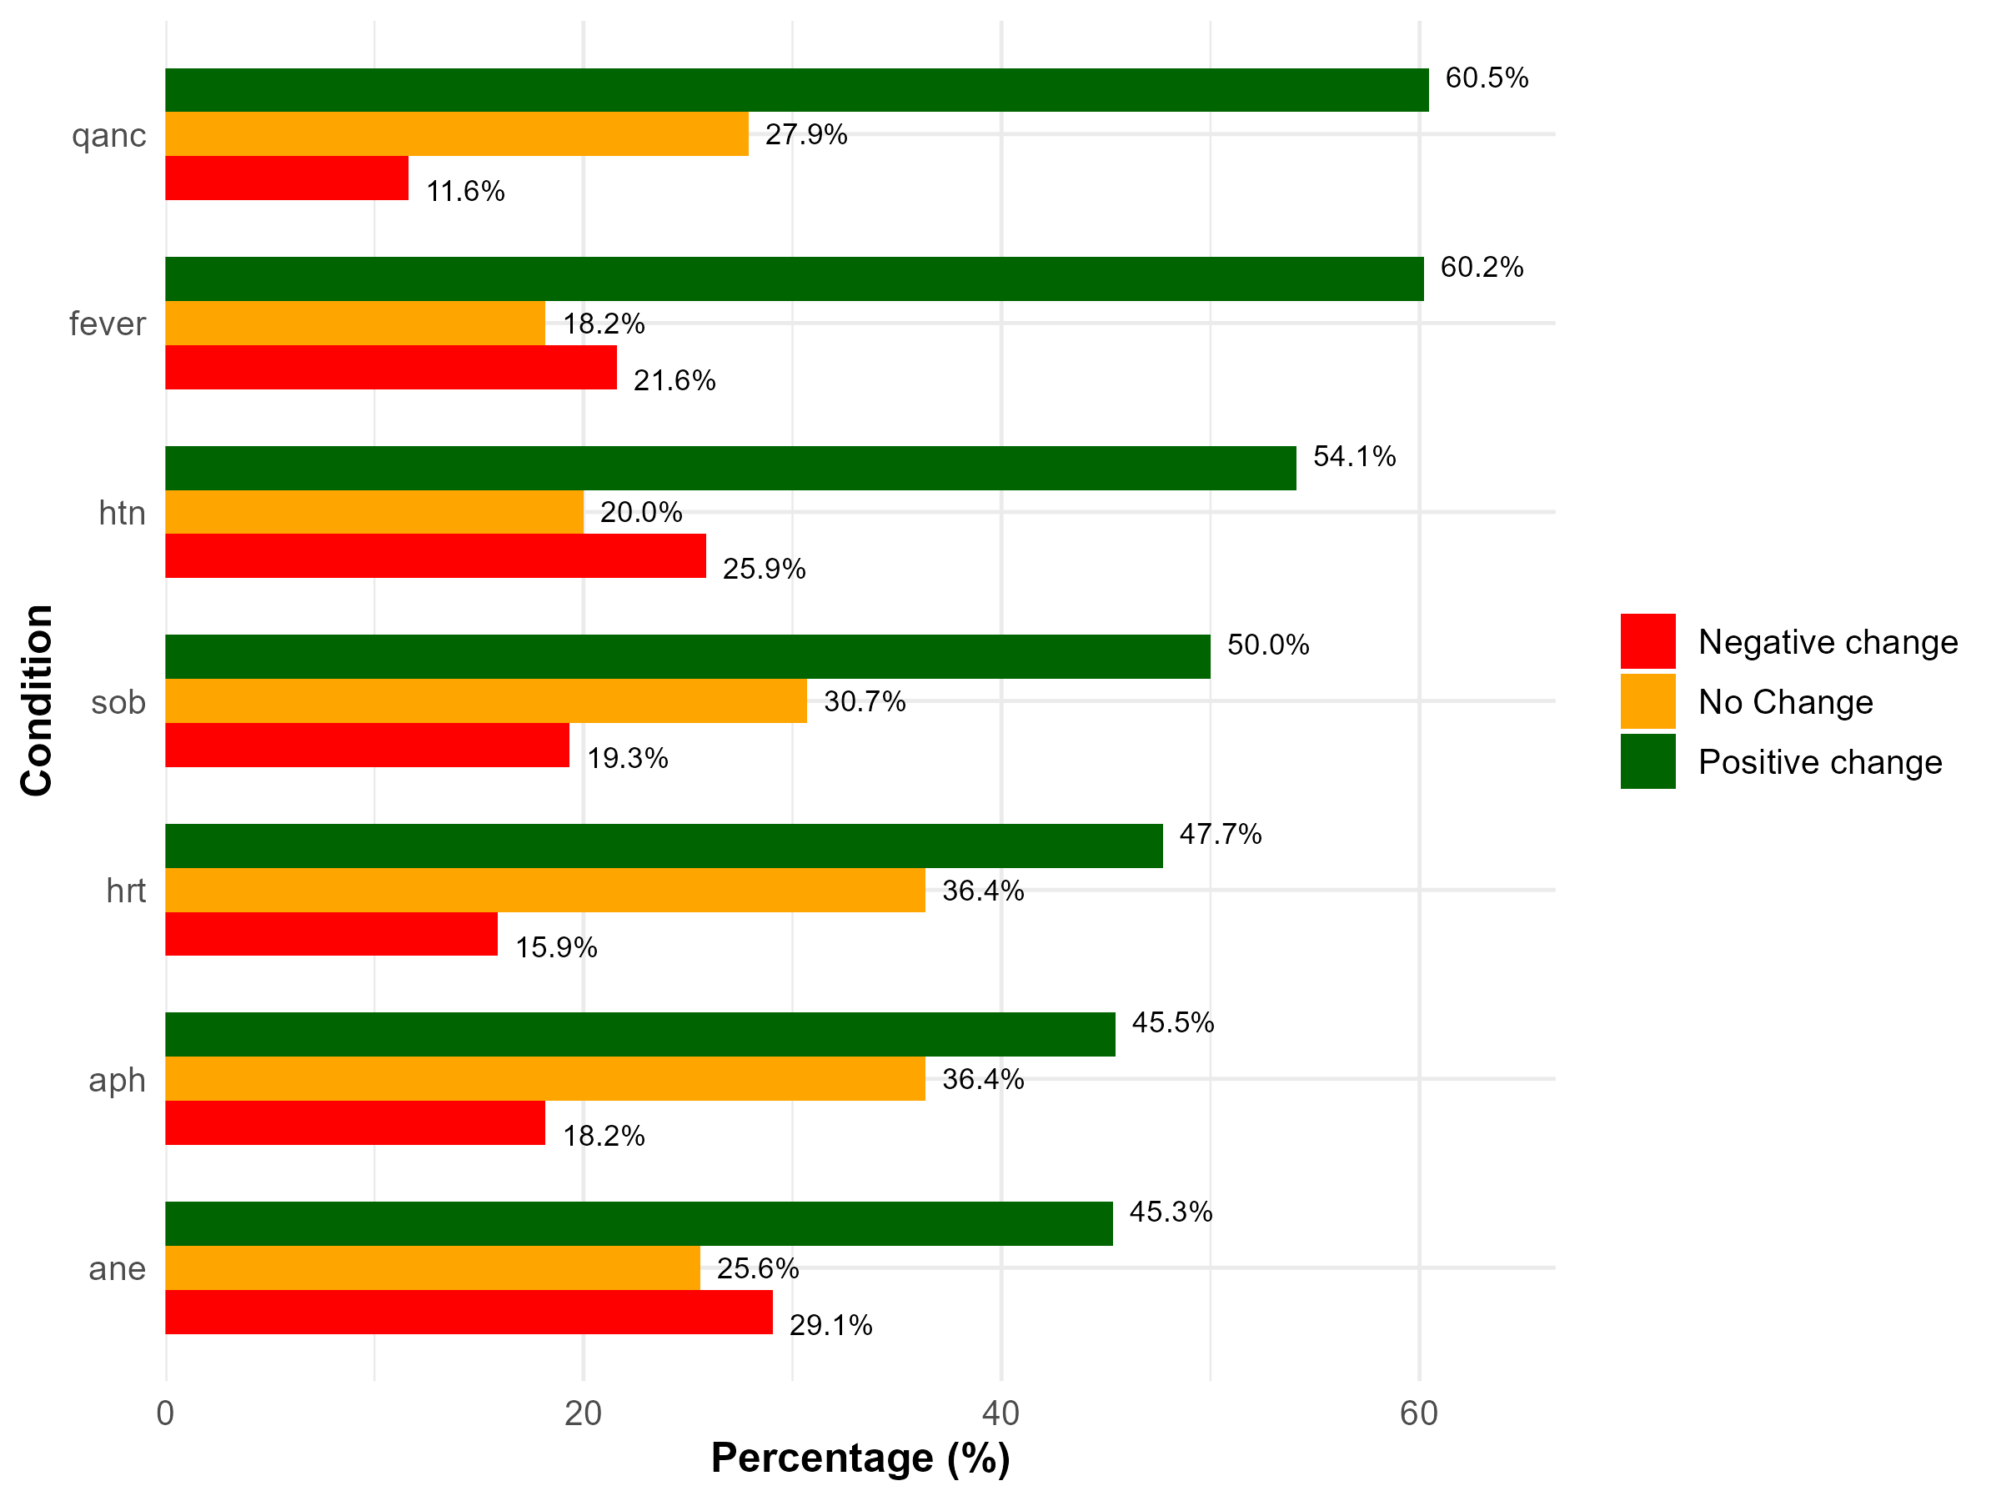
Relative change percentage score of MO & SN
MO
SN

Slide 5
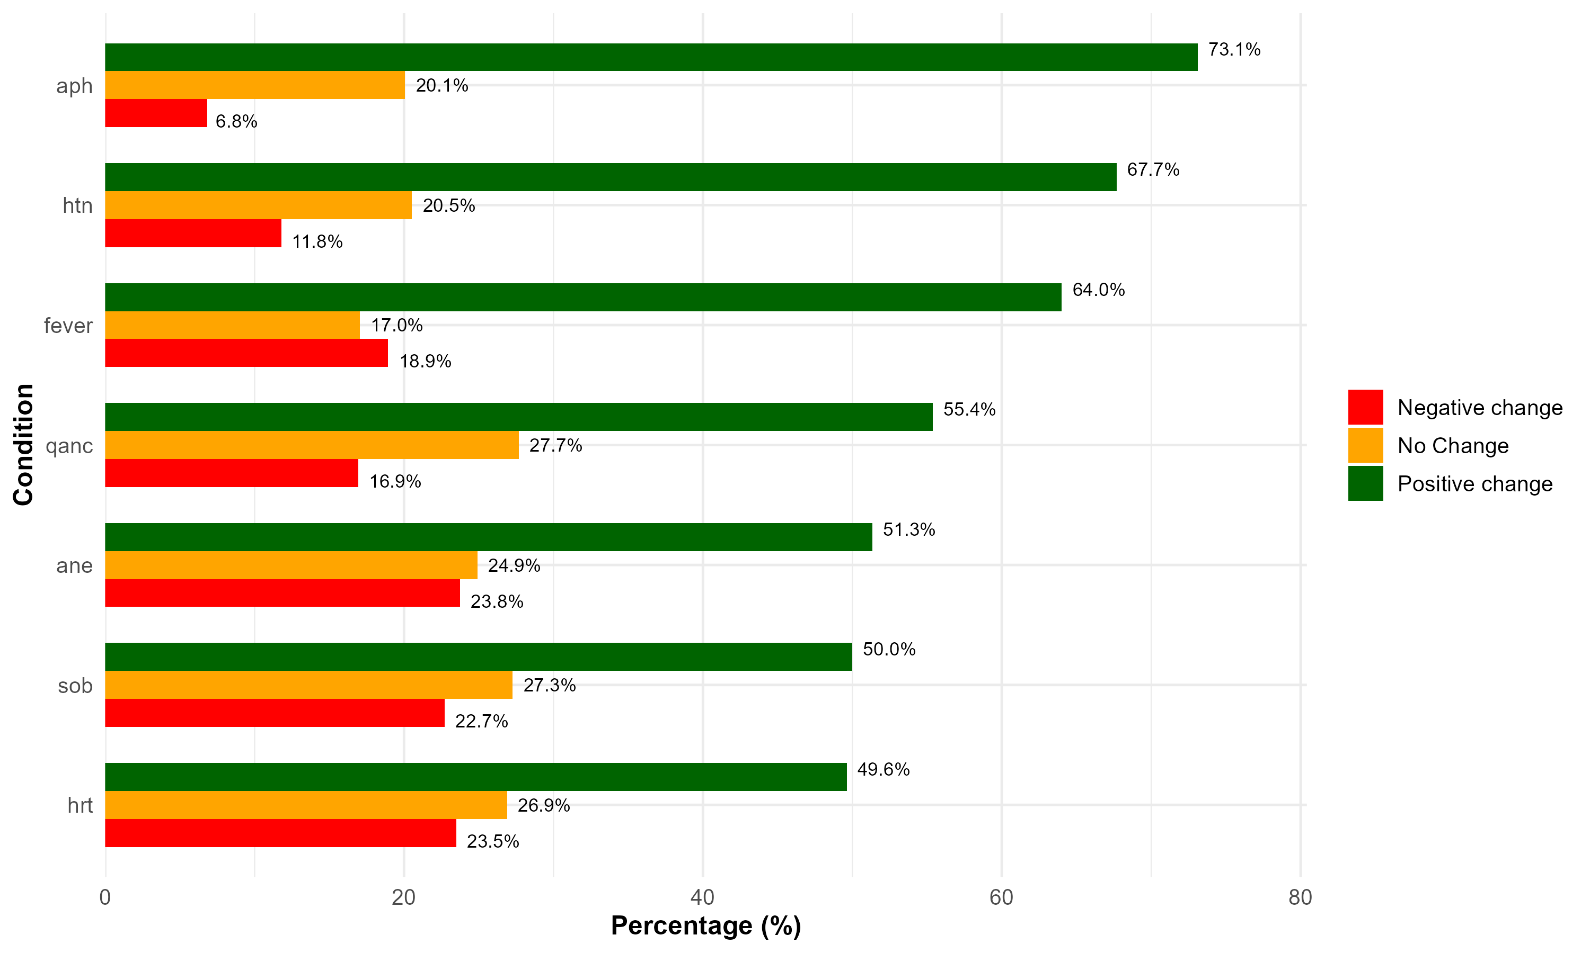
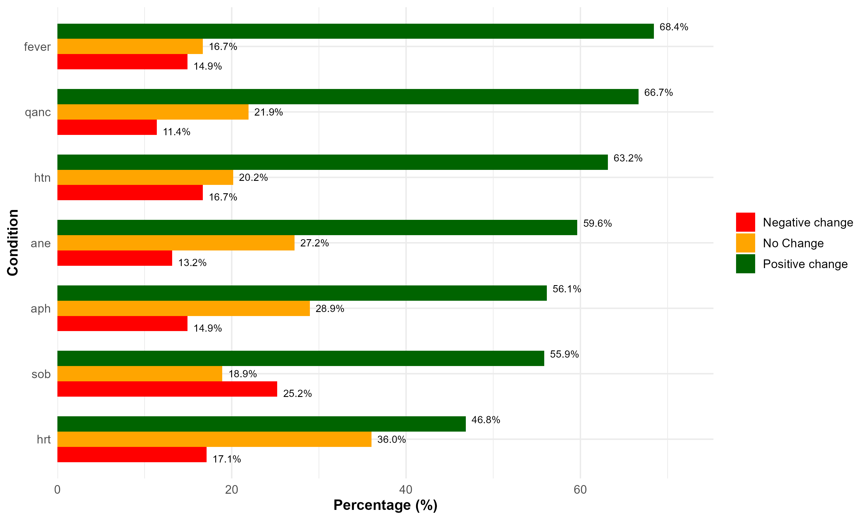
Relative change percentage score of ANM & CHO
ANM
CHO

Slide 6
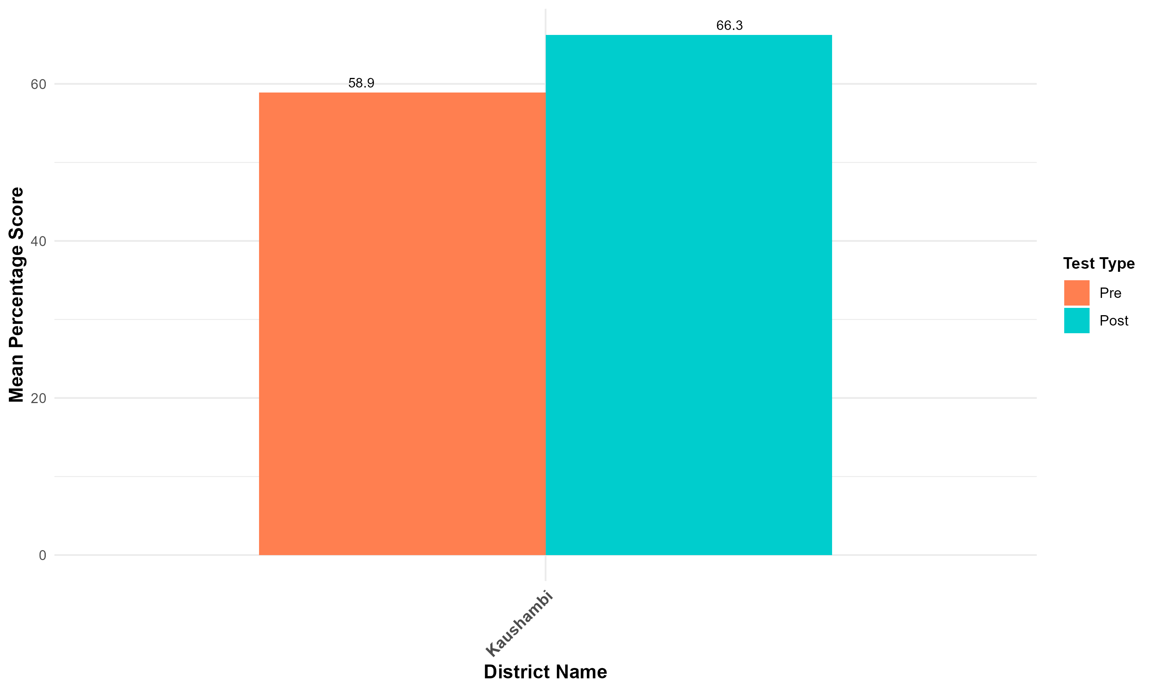
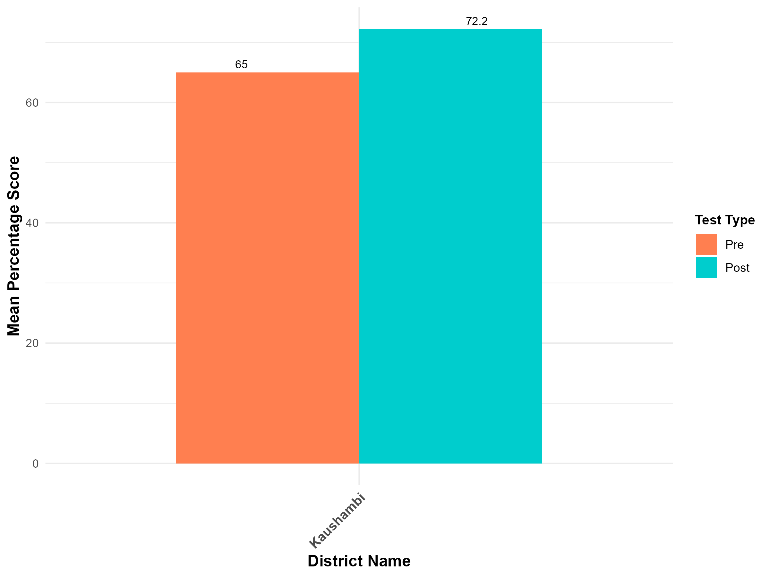
Overall District Mean Percentage Score
MO
SN

Slide 7
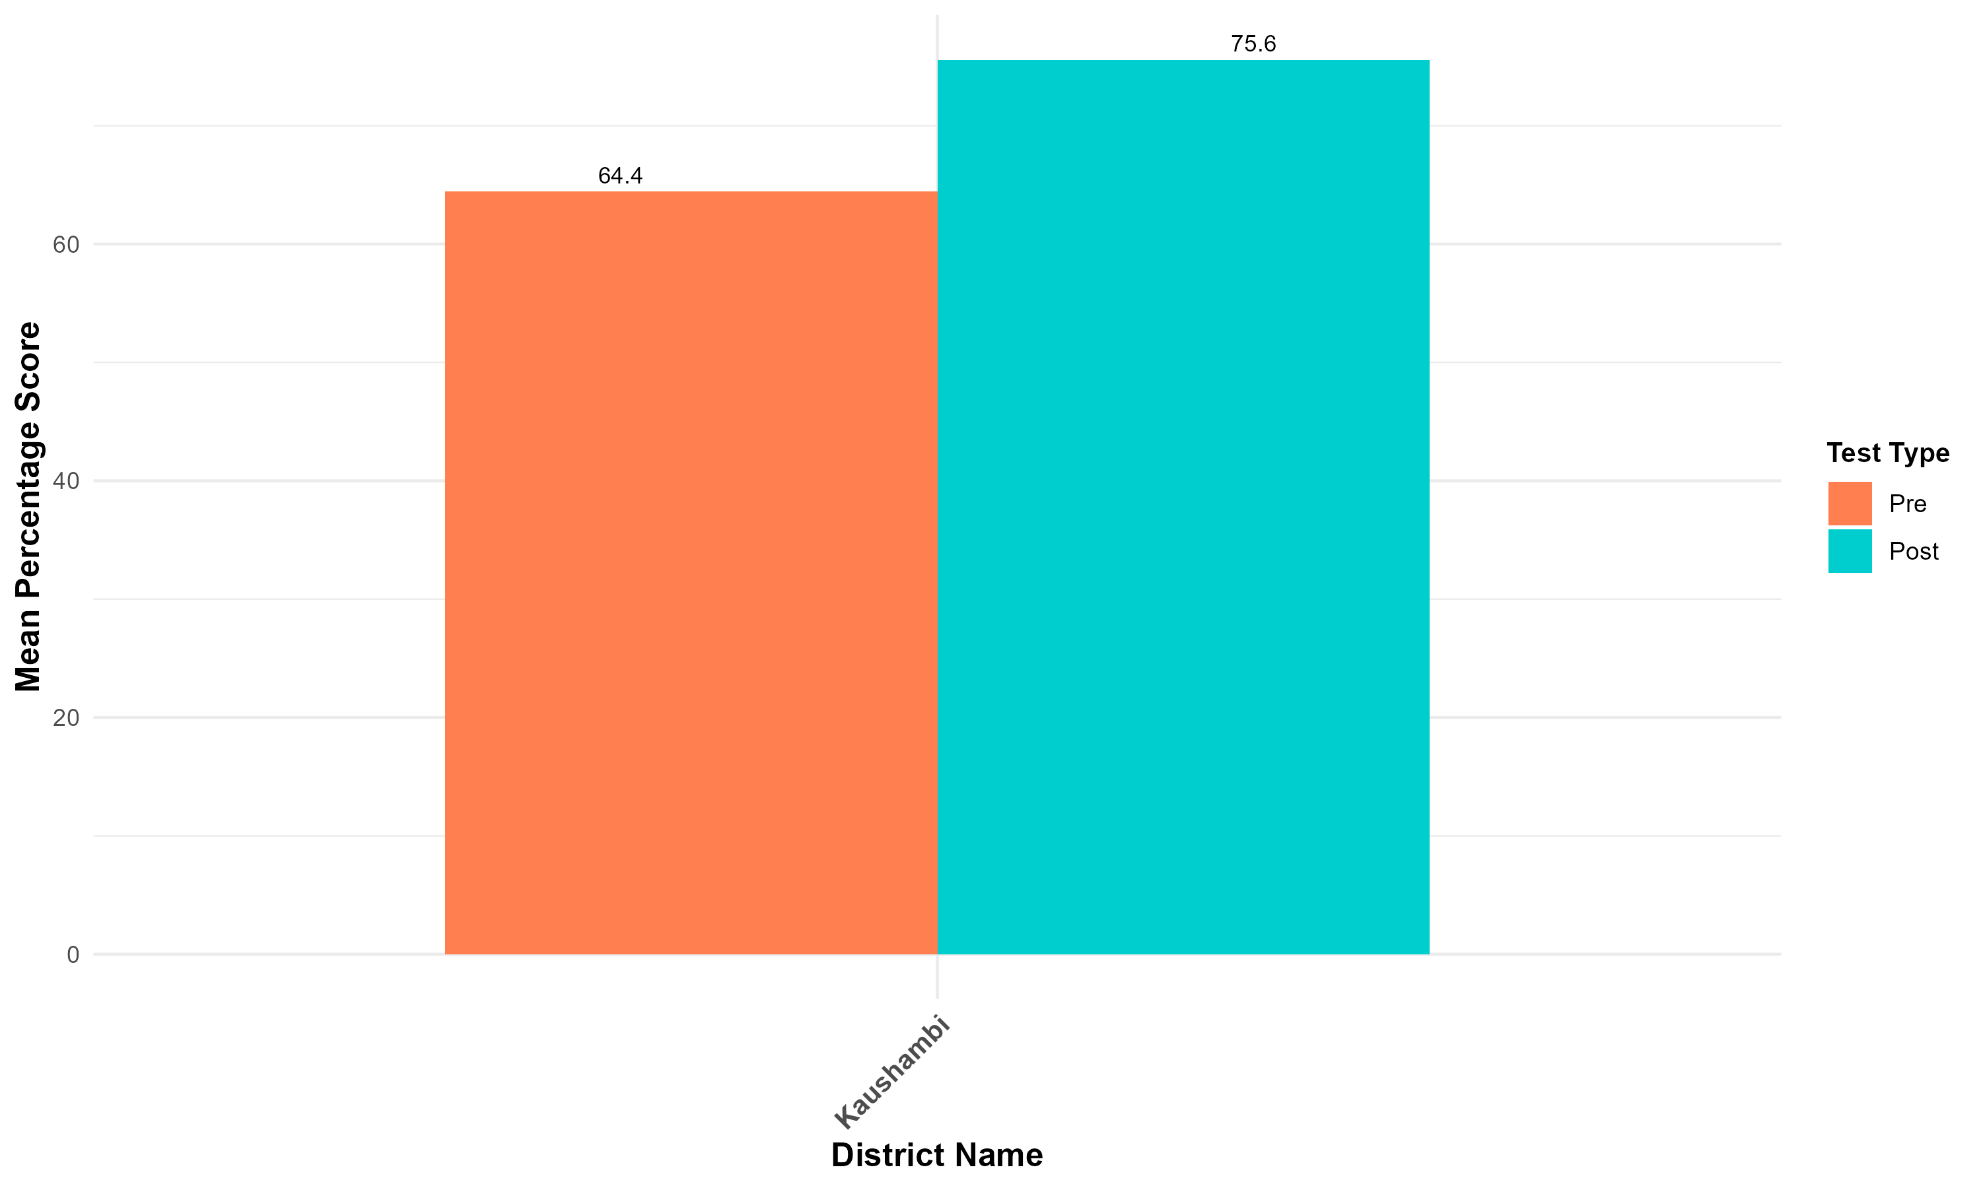
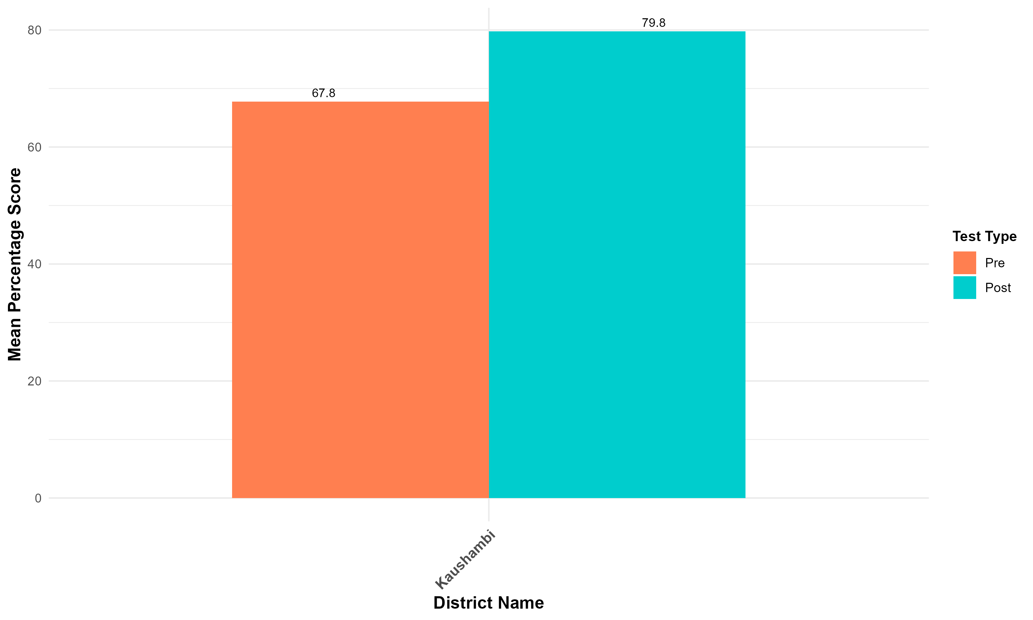
Overall District Mean Percentage Score
ANM
CHO

Slide 8
Question-wise Analysis for MO
*The above yellow code indicates the participants who have scored less than 50% in either the pre or the post test

Slide 9
Question-wise Analysis for SN

Slide 10
Question-wise Analysis for ANM

Slide 11
Question-wise Analysis for CHO

